Slide 1
PREDICTING CRIME IN DC
Debbie Yu | General Assembly | DAT7 | August 10, 2015

Slide 2
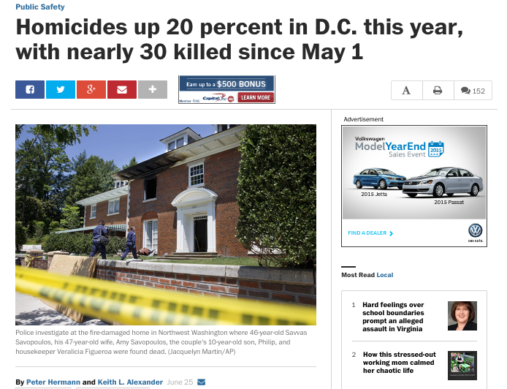
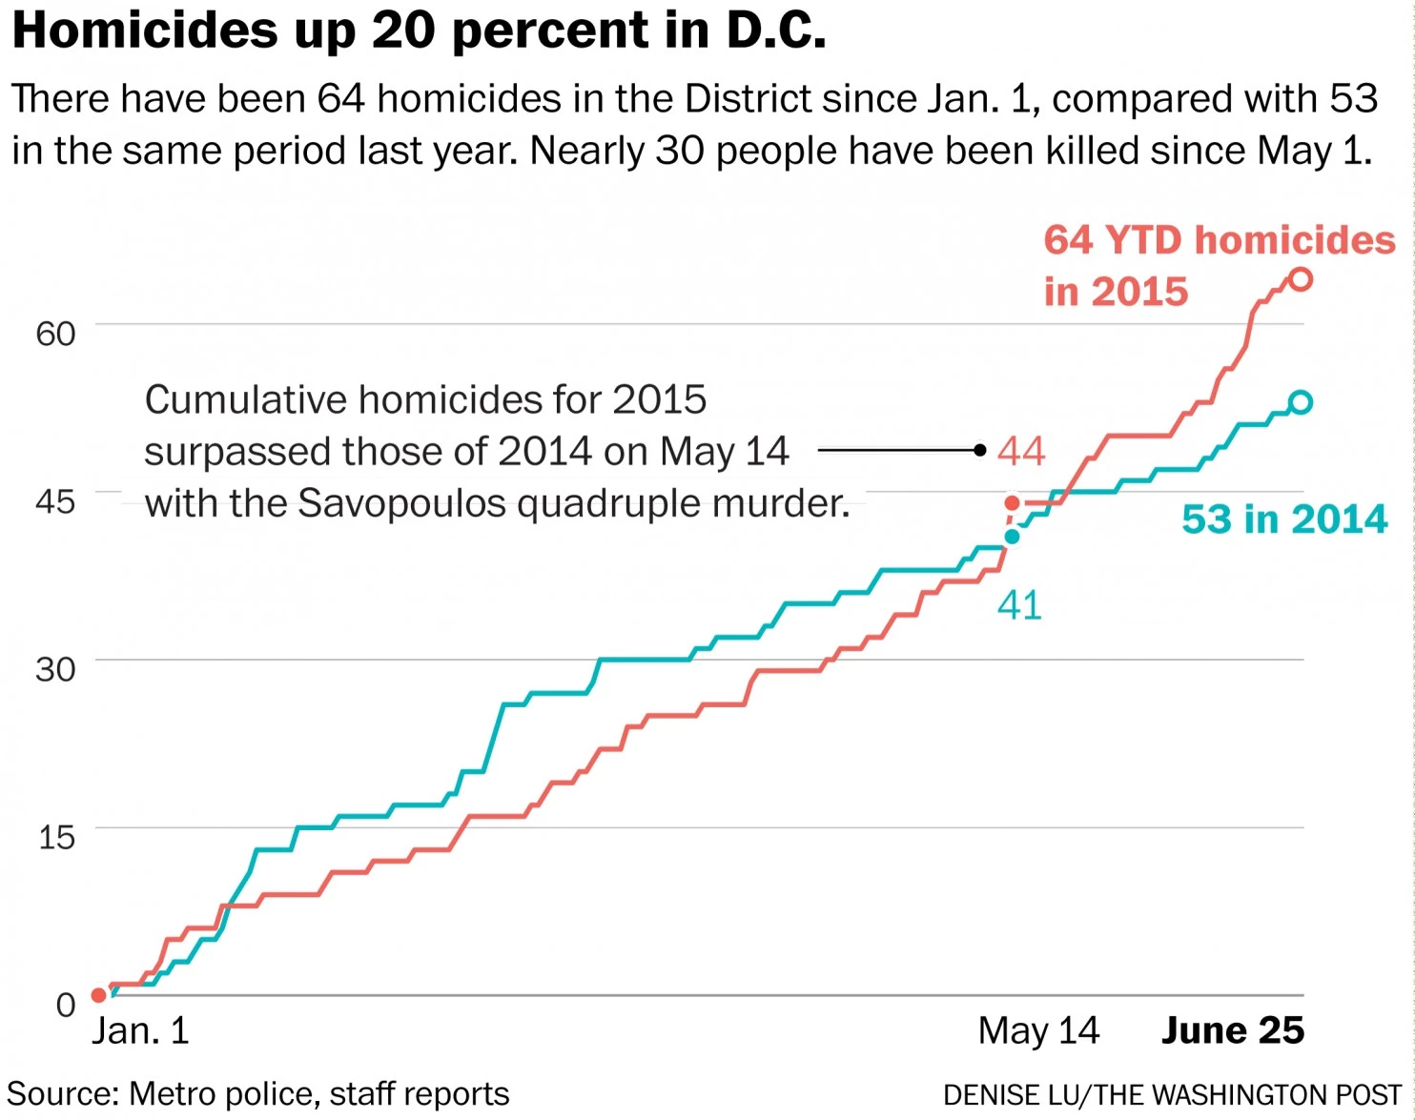
PROBLEM
While crime rates in DC have steadily decreased over the past 20 years, DC still struggles with relatively high crime rates like most major US cities.
Washington Post article from June 25, 2015:
SOURCE: http://www.washingtonpost.com/local/crime/dc-homicides-jump-20-percent-amid-a-surge-in-may-june/2015/06/25/2effd93c-1b37-11e5-93b7-5eddc056ad8a_story.html

Slide 3
QUESTION
Given a crime committed, can I predict whether or not it is a violent crime or nonviolent crime?
Particularly, with a focus on location in DC (e.g. neighborhood), and time of year (e.g season and months)
Violent crime includes: homicide, assault, robbery, sexual abuse
Data sources:
DC Crime data for 2014
DC Neighborhood data
DC Weather for 2014

Slide 4
DATA SOURCES
2014 DC Crime data
Source: DC Government Open Data portal
Shape: (38388, 21)
Rows: Crime incidents for all of 2014
21 Columns:
ccn
reportdatetime
policeshift
offense
method
lastmodifieddate
blocksiteaddress
blockxcoord
blockycoord
ward
anc
district
psa
neighborhoodcluster
businessimprovementdistrict
block_group
census_tract
voting_precinct
start_date
end_date
esri_oid
Notes:
Pretty clean

Slide 5
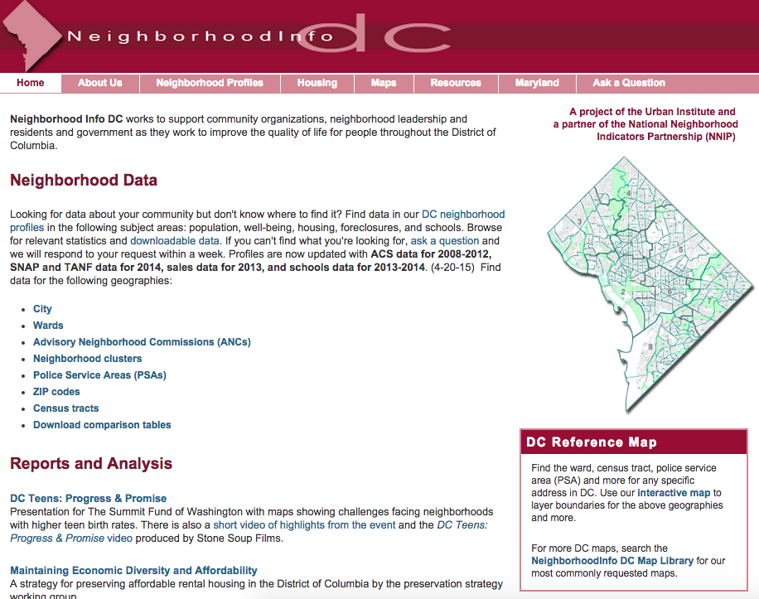
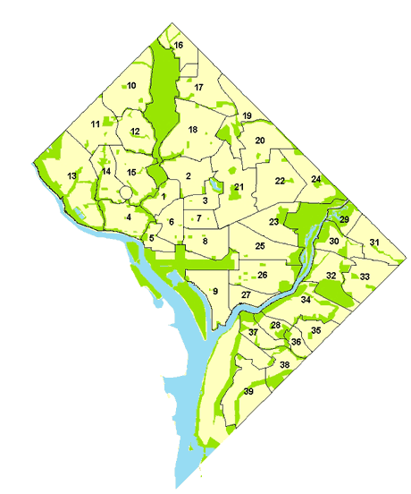
DATA SOURCES
Neighborhood Data
Data is organized by “neighborhood cluster” (groupings of 3-5 neighborhoods throughout DC)
Examples:
Cluster 8: Downtown, Chinatown, Penn Quarter, Mt. Vernon Sq, North Capitol
Cluster 26: Capitol Hill, Lincoln Park
Notes:
ABOUT THE SITE
Built by a collaboration between the Urban Institute and National Neighborhood Indicators Partnership
NNIP is a peer network that is dedicated to promoting the “democratization and use of local data for community building and decision making”
Members of this network belong to over 40 US cities
Networking members and partners have built information systems (e.g. websites, data portals, etc..) to keep updated information on neighborhood-level data in cities
Their focus is to enable city and community leaders with information about their neighborhood-level data, whic
PURPOSE OF THE SITE
Clean and store data files from DC Office of Planning, Metropolitan Police Department, Office of the CTO, Department of Human Services, Office of Income Maintenance
create indicators in standardized geographies
You can see data by Council Ward, ANC (Advisory Neighborhood Commissions – sub-divisions within wards), and Neighborhood Cluster
Neighborhood clusters – groupings of 3-5 neighborhoods throughout the city, and there 39 groupings. Clusters are used by the DC government for budgeting, planning, service delivery and analysis
Single neighborhoods aren’t used as a geographic unit because there’s a lot of debate about the boundaries of neighborhoods and those boundaries tend to change over time. While the boundaries of the clusters may move over time, these are designated by the distfct and all boundaries and changes are publicly available.

Slide 6
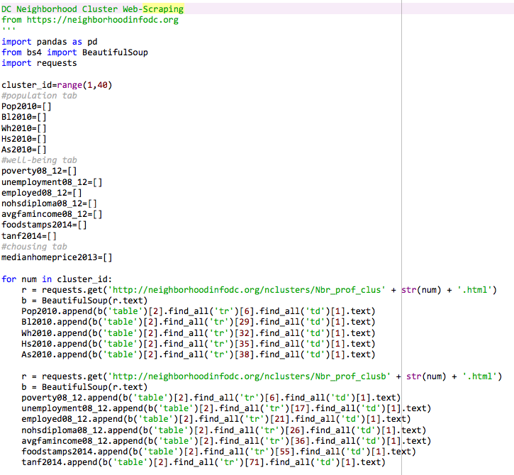
DATA SOURCES
Neighborhood Data Web Scraper
Features Scraped for each neighborhood cluster:
population 2010
%African American
%white
%hispanic
%asian
poverty_rate 2008-2012
unemployment rate 2008-2012
employment rate 2008-2012
no high school diploma 2008-2012
average family income 2008-2012
% receiving food stamps 2014
% receiving TANF 2014
Notes:
TANF: https://en.wikipedia.org/wiki/Temporary_Assistance_for_Needy_Families

Slide 7
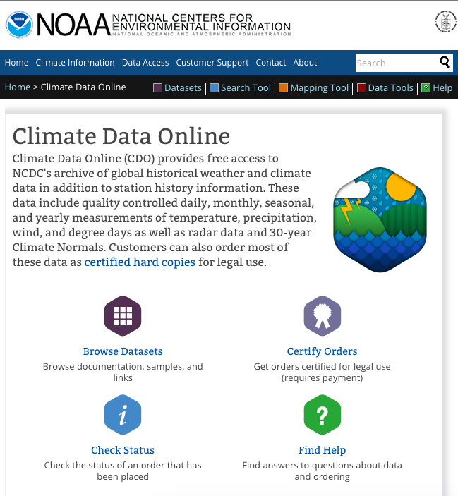
DATA SOURCES
DC Weather for 2014 from NOAA
Retrieved csv file of daily temperature recordings for DC weather stations in 2014
Reagan National Airport weather station
Features:
Date
Max Temp
Min Temp
Snow
Rain
Notes:
TANF: https://en.wikipedia.org/wiki/Temporary_Assistance_for_Needy_Families

Slide 8
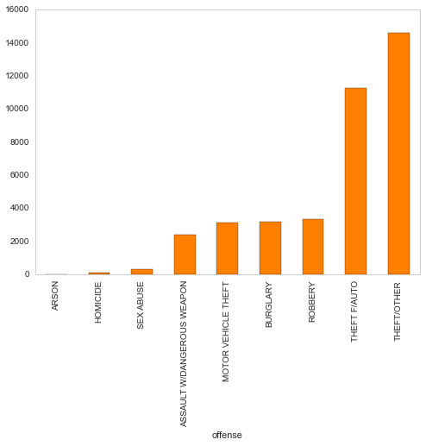
DISTRIBUTION OF CRIME TYPES IN DC
Class imbalance between violent and nonviolent crimes
Data was downsampled to even the distribution of violent vs. nonviolent crimes
Dataframe size downsampled to ~12000 rows
Notes:
Theft/Other: A broad inclusion of Theft offenses including embezzlement, theft of services and fraud/false pretenses. The Theft/Other category excludes theft of items from a motor vehicle or the motor vehicle itself.
Would be interesting to remove theft/other
Would I need separate models for violent crimes (exclusing theft/other)

Slide 9
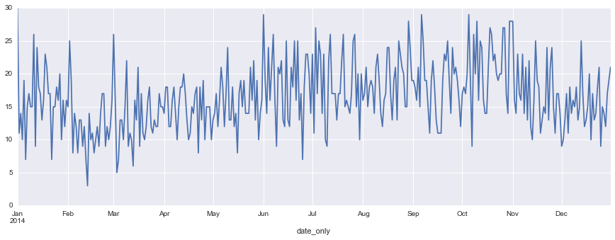
2014 DAILY VIOLENT CRIME COUNT

Slide 10
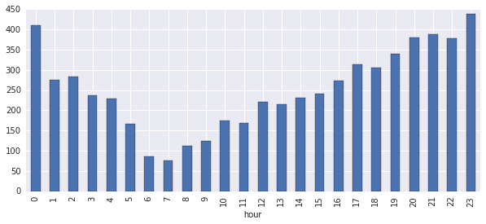
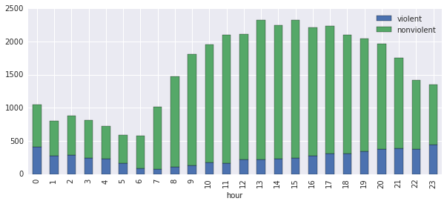
VIOLENT & NONVIOLENT CRIMES BY HR
VIOLENT CRIMES BY HOUR
VIOLENT & NONVIOLENT CRIMES BY HOUR
Notes:
Theft/Other: A broad inclusion of Theft offenses including embezzlement, theft of services and fraud/false pretenses. The Theft/Other category excludes theft of items from a motor vehicle or the motor vehicle itself.
Would be interesting to remove theft/other
Would I need separate models for violent crimes (exclusing theft/other)

Slide 11
MODELS USED
Decision Trees
Random Forests
Logistic Regression
Use DTs to determine most important features; use those features for logistic regression model
Null hypothesis: 0.501

Slide 12
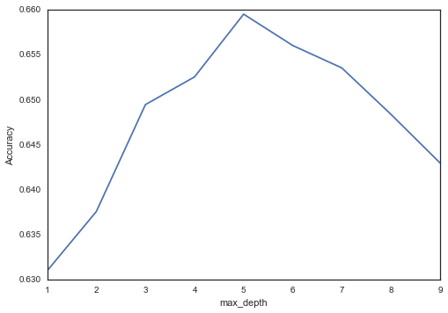
MODEL #1: DECISION TREES
Decision Tree Classifier – looped through max depth ranges using 11 possible features
Day/Night
Median home prices
Census tract
Poverty rate
Rain
Snow
People employed over 16
Weekend
Month
Avgfamily income
Unemployment rate
% pop no hs diploma
I had a lot of features that are highly correlated (e.g. poverty rate and % of population receiving food stamps); I only picked subsets of these features and then wanted to see how DTs handled the relationship between different variables

Slide 13
MODEL #1: DECISION TREES
Decision Tree with max depth 5
Observations:
Tree split in places I would have expected (e.g. time of day and day of the week)
Top 5 features:
Avg family income
Time of day (day vs night)
Census Tract
Weekend
Unemployment rate
Pitfalls:
Since DTs make locally optimal splits, it could still leave in features that are globally correlated (e.g. avg family income and unemployment rate)
Gini scores are fairly high (above 0.45) for many of the nodes; thus nodes are less “pure”
Consistent with the best possible accuracy score just under 0.66

Slide 14
MODEL #2: RANDOM FORESTS
Using the same features used for DTs, my next model used was Random Forests
# of estimators: 150
Max features: 5
Out of bag error: 0.621, better than the null but not by much
Different ordering of feature importance!
Month
Census Tract
Precipitation
Avg family income
Day vs night
OOB is lower than accuracy score for DTs
‘Month’ was not chosen in DTs

Slide 15
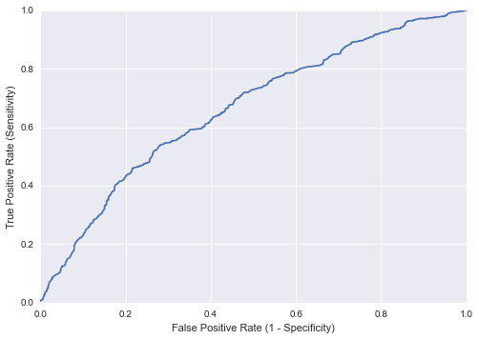
MODEL #3a: LOGISTIC REGRESSION
First model using top features determined by DTs
Avg family income
Time of day (day vs night)
Census Tract
Weekend
Unemployment rate
Train, test, split accuracy score: 0.6115
Cross val score (mean): 0.6230
AUC: 0.6617, ROC:
 | Predicted No | Predicted Yes
Actual No | 1058 | 455
Actual Yes | 689 | 836
Sensitivity: 836/(689+836) = 0.54
Specificity: 1058/(1058+455) = 0.69

Slide 16
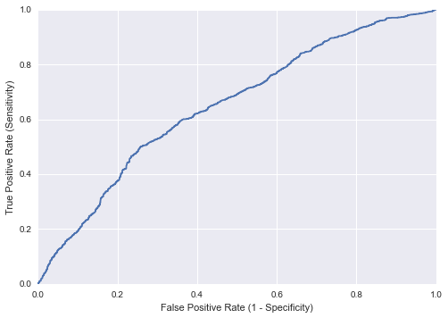
MODEL #3b: LOGISTIC REGRESSION
Second model using top features determined by random forests
Month
Time of day (day vs night)
Census Tract
Avg family income
Rain
Train, test, split accuracy score: 0.6119
Cross val score (mean): 0.6167
AUC: 0.6488, ROC:
 | Predicted No | Predicted Yes
Actual No | 950 | 582
Actual Yes | 599 | 907
Sensitivity: 907/(599+907) = 0.60
Specificity: 950/(950+582) = 0.62

Slide 17
TAKEAWAYS/NEXT STEPS
Grand lesson: more opportunities for better FEATURE COLLECTION AND ENGINEERING!
Lots of features…not a whole lot of which were useful
Gathered too many features that were correlated
Gathered features that were possibly at the wrong ‘scale’, geographically (e.g. neighborhood cluster vs. census tract)
Probably could have explored the features I had a bit more
Next steps:
Continue to explore the features I have
Use dummy variables for neighborhood clusters or census tract
Explore geopandas/how to use geospatial data better

Slide 18
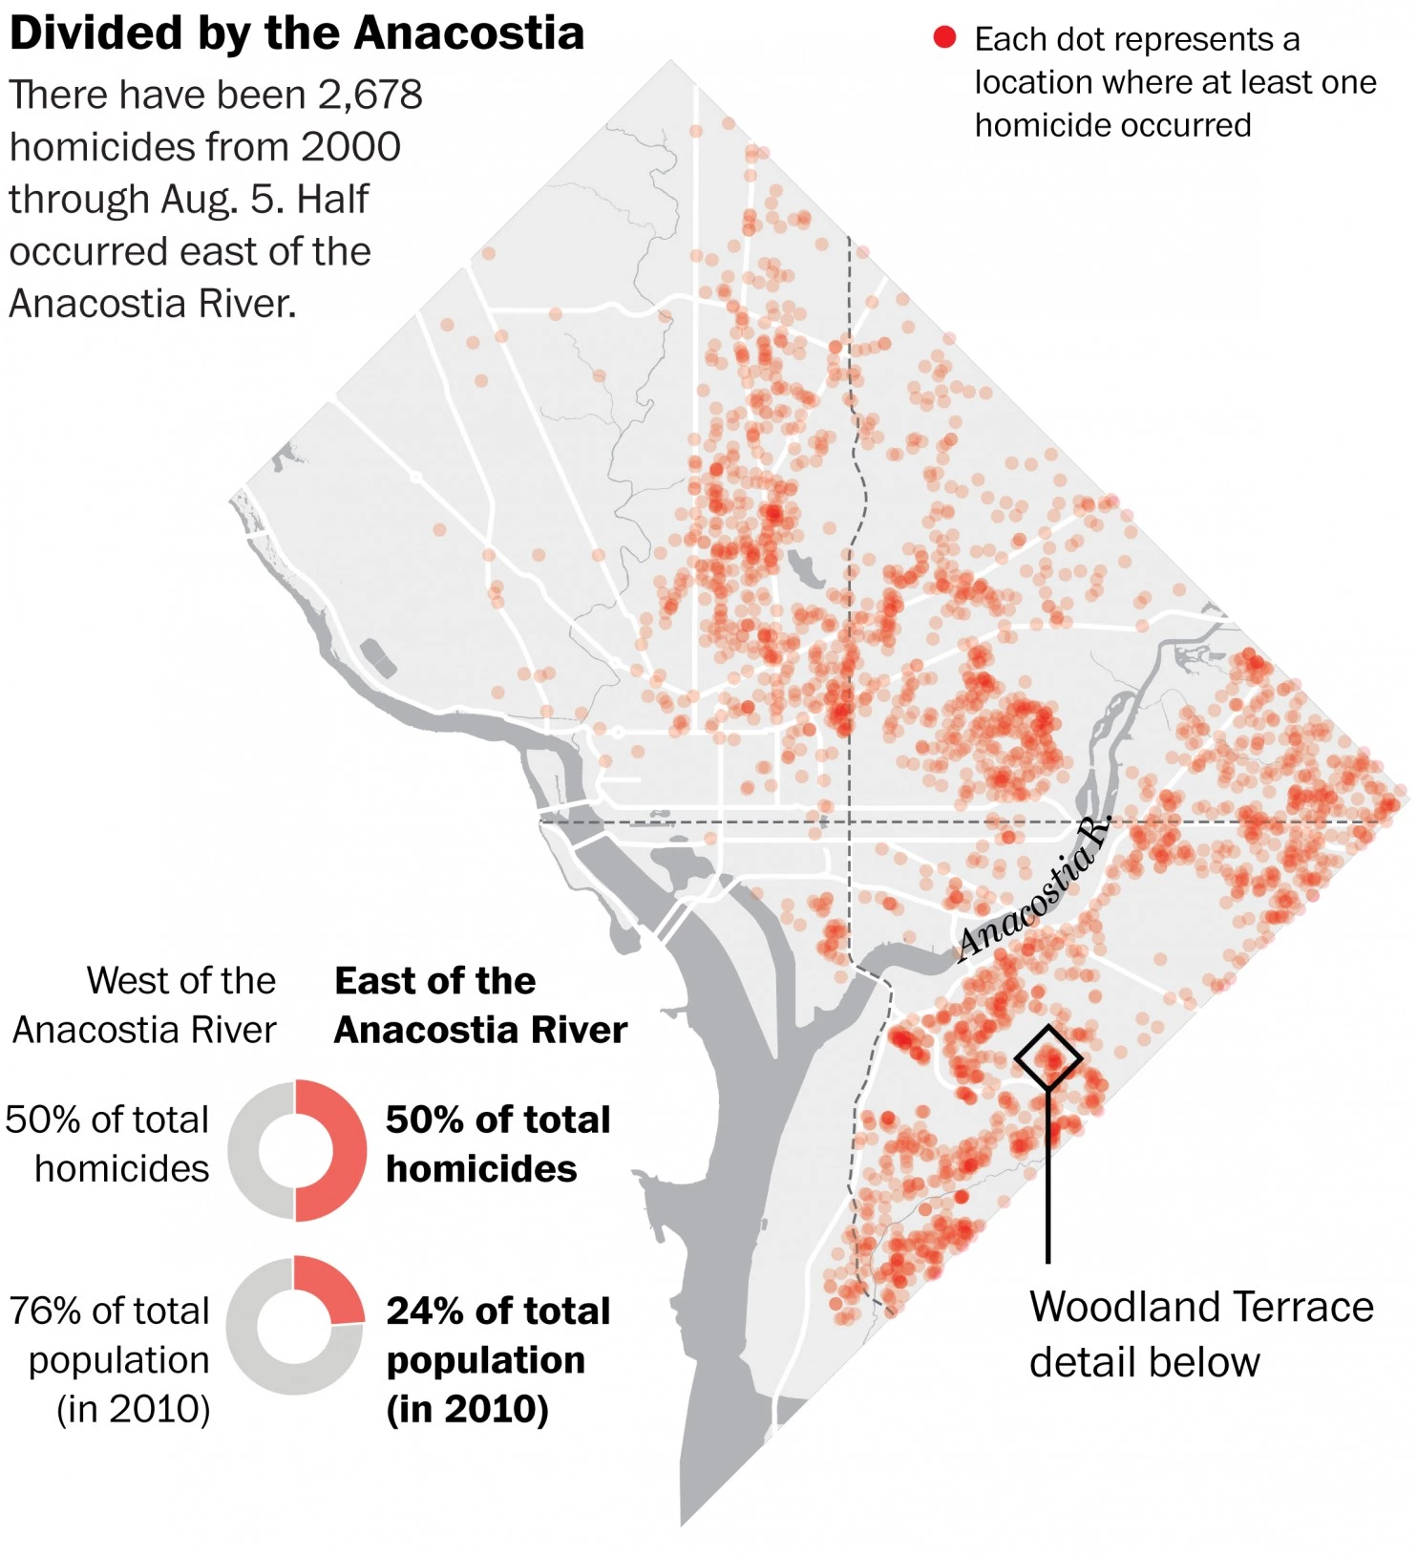
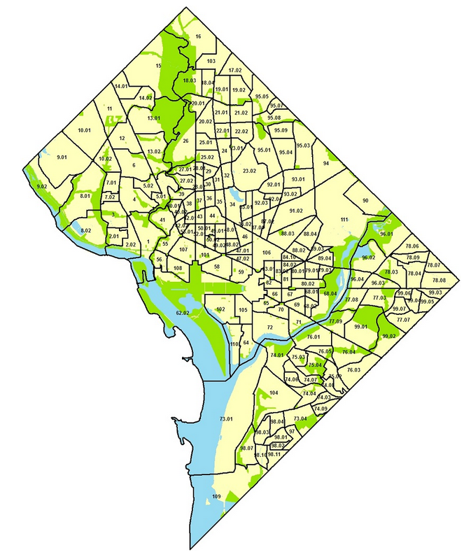
NOTE ON ‘CENSUS_TRACT’
Census tract is currently represented in the data as a number (e.g. 1 through 111)
There is no ordinal value to the numbering, but the numbers correspond generally to the geographic quadrants in DC and homicide rates
Census tracts numbered above 75 contain all of the areas in DC that have the highest homicide rates
Probably should have created dummy variables with this feature
Homicide graphic source:http://www.washingtonpost.com/local/crime/a-deadly-dc-community-that-has-yet-to-improve/2015/08/06/7abf3f60-3c94-11e5-b3ac-8a79bc44e5e2_graphic.html

